Slide 1


Wavecon Telecom
Insights from Power BI Dashboard
This presentation is part of data analytics internship by code basics and was prepared solely for learning purpose.

Slide 2

Wavecon is a premier telecom provider in India, renowned for delivering reliable and cutting-edge services.
In May 2022, Wavecon achieved a significant milestone by introducing its latest 5G services, aiming to offer fast and reliable connectivity to customers. This advancement benefits both individuals and businesses by fostering creativity and innovation. Wavecon operates across 15 major cities in India, maintaining a strong and widespread presence and striving to provide uninterrupted connectivity to its users.
The introduction of 5G services marks a new chapter in Wavecon's history of technological excellence.
About
Wavecon Telecom
This presentation is part of data analytics internship by code basics and was prepared solely for learning purpose.

Slide 3

After 5G launch they have seen the decline in the revenue and active users. So, they want to know about the following objectives.
1. What is the impact of the 5G launch on our revenue?
2. Which KPI is underperforming after the 5G launch?
3. After the 5G launch, which plans are performing well in terms of revenue? Which plans are not performing well?
4. Is there any plan affected largely by the 5G launch? Should we continue or discontinue that plan?
5. Is there any plan that is discontinued after the 5G launch? What is the reason for it?
Evaluation
Criteria
This presentation is part of data analytics internship by code basics and was prepared solely for learning purpose.

Slide 4
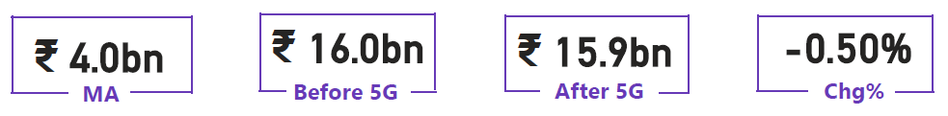
What is the impact of the 5G launch on our revenue?
KEY HIGHLIGHTS
Overall revenue dipped slightly by 0.5% after the 5G rollout.
Mumbai remains the top revenue generator (₹4.9bn total).
Raipur, though lowest in revenue, grew by +1.15% post-5G.
Lucknow showed the highest growth.
Delhi recorded the sharpest drop (-2.83%), while other metros stayed stable.
Monthly average revenue holds steady at ₹4bn, showing stable performance across months.
This presentation is part of data analytics internship by code basics and was prepared solely for learning purpose.

Slide 5
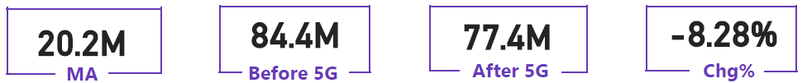
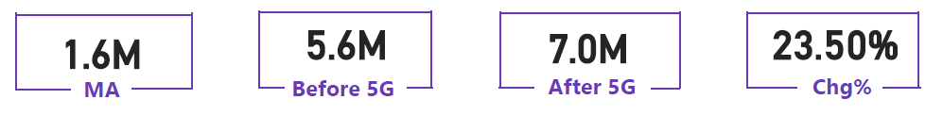
Which KPI is underperforming after the 5G launch?
TAU
TUsU
KEY HIGHLIGHTS
7 million user drop suggests revenue decline.
Pune's 18.06% increase in active users stands out.
Ahmedabad shows the most impact on user base.
Lucknow recorded a 77% rise in unsubscribed users, possibly due to 5G service dissatisfaction.
This presentation is part of data analytics internship by code basics and was prepared solely for learning purpose. TAU- Total Active User, TUsU – Total Unsubscribe Users

Slide 6
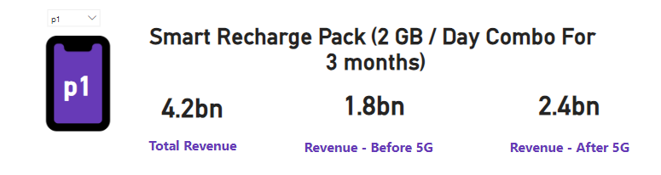
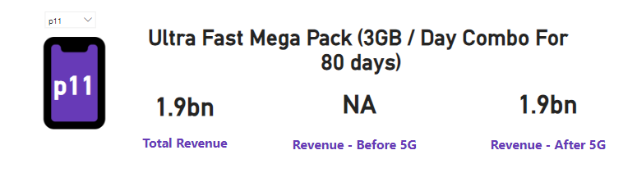
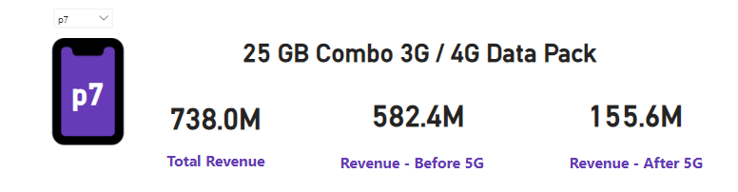
After the 5G launch, Which plans are performing well in terms of revenue? Which plans are not performing well?
KEY HIGHLIGHTS
Plan P1 & P11 show increase in revenue trends.
Among all plans, P11 consistently generates the highest revenue.
Plan P7 show lowest revenue compared to all other plans
This presentation is part of data analytics internship by code basics and was prepared solely for learning purpose.

Slide 7
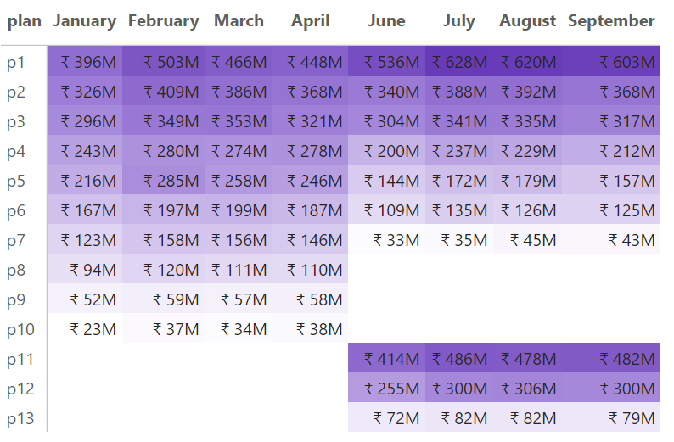
Is there any plan affected largely by the 5G launch? Should we continue or discontinue that plan?
KEY HIGHLIGHTS
Smart Recharge Pack (p1): Revenue increased from ₹1.8B to ₹2.4B, indicating strong performance.
Ultra Fast Mega Pack (p11): New 5G plan, quickly generating ₹1.9B in revenue.
Ultra Duo Data Pack (p12): New 5G plan, achieving ₹1.2B in revenue, showing positive customer response.
25 GB Combo 3G/4G Data Pack (p7) faced a significant revenue drop from ₹582.4 M to ₹155.6 M due to the 5G launch, suggesting it should be discontinued.
This presentation is part of data analytics internship by code basics and was prepared solely for learning purpose.

Slide 8
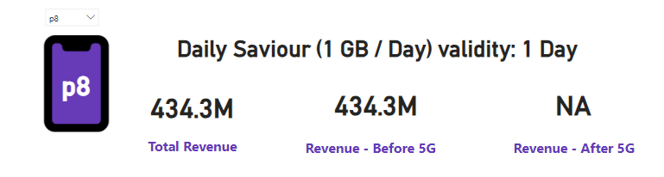
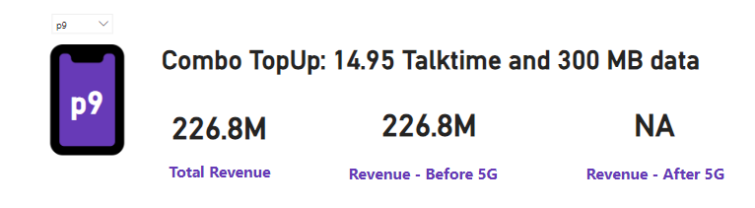
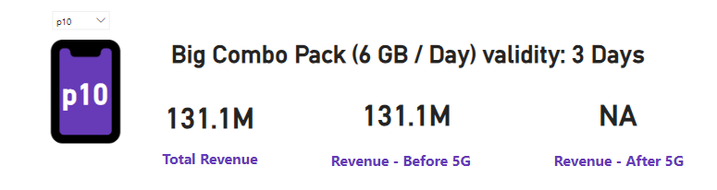
Is there any plan that is discontinued after the 5G launch? What is the reason for it?
KEY HIGHLIGHTS
Plan P8 - Daily Saviour (1 GB/Day): Discontinued due to short validity and inadequate data for 5G demands.
Plan P9 - Combo TopUp (14.95 Talktime and 300 MB Data): Discontinued as consumer preference shifted towards plans with more data and talk time.
Plan P10 - Big Combo Pack (6 GB/Day): Discontinued because of its short 3-day validity not meeting customer expectations for flexibility in data usage.
This presentation is part of data analytics internship by code basics and was prepared solely for learning purpose.

Slide 9
Recommendations :
Network Experience:
Enhance 5G coverage and reduce latency for smoother connectivity.
Retention Strategy:
Re-engage users in high-drop cities with targeted offers.
Pricing Alignment:
Revise 5G plans for better affordability and transparency.
Customer Engagement:
Strengthen feedback channels and quick issue resolution.
Performance Tracking:
Use live KPIs to detect and address churn early.
Service Innovation:
Bundle 5G with new digital and entertainment features.
Awareness & Education:
Promote 5G benefits and device readiness through campaigns.
This presentation is part of data analytics internship by code basics and was prepared solely for learning purpose.

Slide 10
Resources :
Presentation Idea: Bain & Company
Image Source: www.unsplash.com
www.pexels.com
AtliQ Logo: www.google.com
Data Analytics Internship: www.codebasics.io
Live Power BI Dashboard: click to view
Interactive report by
Sagar Murmu@ Data Analyst Intern
Do you have any question related to presentation?
Please email sagar14011991@gmail.com
This presentation is part of data analytics internship by code basics and was prepared solely for learning purpose.

